Slide 1
Scalability

Slide 2
Introduction
Cloud scalability in cloud computing refers to increasing or decreasing IT resources as needed to meet changing demand.
Most popular and beneficial features of cloud computing, as businesses can grow up or down to meet the demands depending on the season, projects, development, etc.
Data storage capacity, processing power, and networking can all be increased by using existing cloud computing infrastructure.
Using existing cloud infrastructure, scaling can be done quickly and easily, usually without any disruption or downtime.
In the past, when scaling up with on-premises physical infrastructure, the process could take weeks or months and require exorbitant expenses.
Third-party cloud providers already have the entire infrastructure in place.

Slide 3
Types of scaling
Vertical Scalability (Scaled-up)
horizontal scalability(Scaled out)
Diagonal scalability

Slide 4
Horizontal Scaling
It involves adding more machines or nodes to a system, while vertical scaling involves adding more power (CPU, RAM, storage, etc.) to an existing machine.
It is also called Scaling out.
Horizontal scaling is typically used to handle increasing amounts of traffic or workload.
As an analogy, scaling horizontally is about hiring new employees for an additional client/problem set.

Slide 5
Horizontal Scaling Continued…
Pros:
Easier Scaling from Hardware additions
Enhanced Flexibility
Lesser Downtime
Offers Redundancy
Cons:
Higher initial costs involved
Harder to maintain

Slide 6
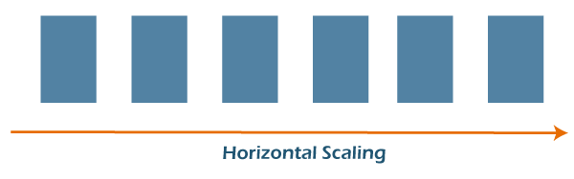

Slide 7
Vertical Scaling
Vertical scaling, often known as “scaling up,” is the process of increasing the power of an existing system, such as the CPU or RAM, to meet the rising demands.
It is also called Scaling Up.
The memory, storage, or network speed can be vertically scaled.
Vertical scaling can also refer to completely replacing a server or shifting the workload from an outdated server to an updated one.
As an analogy, Vertical scaling is about upskilling existing employees for an additional client/problem set.

Slide 8
Vertical Scaling Continued…
Pros:
Cost Effective
Less Complexity involved
Easier to maintain
Cons:
More Downtime possibilities
Very less flexibility
Single Point of Failure

Slide 9
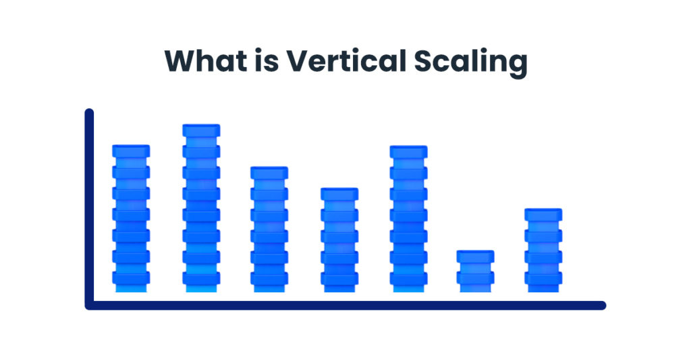

Slide 10
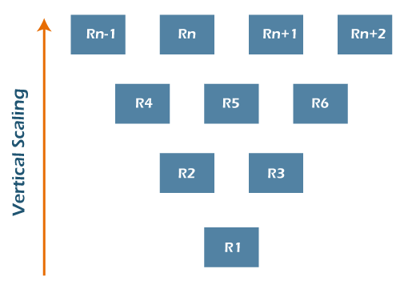

Slide 11
Diagonal Scaling
It is a mixture of both Horizontal and Vertical scalability where the resources are added both vertically and horizontally.
Well, you get diagonal scaling, which allows you to experience the most efficient infrastructure scaling.
This constitutes upgrading and adding components to a single server up to the critical point of cost-effectiveness, or having reached full server specification, and
Then replicating the server in its current configuration.
This offers the most effective scaling mechanism, both in terms of price and performance.

Slide 12
In practice, the computing power of a single server is fortified by increasing the number of CPU cores, main memory and disk storage.
Once the server’s computing power has reached its peak, or it is no longer cost-effective to add components to it, similar servers are added to the structure to increase it horizontally.

Slide 13
Scalability Vs Elasticity
Scalability is the ability of a system to add, remove, or reconfigure the hardware, software, and other resources to handle an increase or decrease in usage. This allows a system to meet the demands of a variable workload.
For example, scalability would allow a system to increase the number of servers or other resources if the usage suddenly spikes. This scalability can be achieved by manually increasing the resources or through automation with self-service tools that allow for scalability on demand.

Slide 14
Scalability Vs Elasticity Contd…
Elasticity, on the other hand, refers to a system’s ability to automatically scale up or down resources to meet user demands. This scalability can occur without manual intervention, meaning that a system can expand or contract resources independently when needed.
Elasticity is especially useful for businesses constantly experiencing fluctuating usage patterns, such as companies providing streaming services like video or audio.

Slide 15
Scalability Vs Elasticity Contd…
This means scalability requires more effort to manage resources, while elasticity can scale with minimal effort.

Slide 16
Benefits of Cloud Scalability and Elasticity
Cost Efficiency
Cloud scalability and elasticity enable companies to have the system they need and calculate power without the expense of purchasing and setting up equipment. Since companies only pay for things they need and use, there’s no waste on capacity and resources that aren’t being used. In addition, you can also avoid other expenses, such as resource management and storage, since scalability allows you to use what you need when you need it.
Faster Implementation
With scalability and elasticity, companies can quickly scale up resources to meet demand. This scalability can be accomplished quickly, making scalability and elasticity ideal for businesses experiencing sudden changes in usage. At the same time, scalability and elasticity can also scale down resources when use is low, allowing companies to save on costs.

Slide 17
Benefits of Cloud Scalability and Elasticity
Service Availability
Companies can plan to meet their usage demands without worrying about downtime. With scalability and elasticity, companies can quickly scale up or down resources to keep their services running smoothly during times of need. In addition, scalability and elasticity can help companies avoid costly over-provisioning of resources by scaling up or down when needed.
Agility
In contrast to the effort required for scalability, scalability and elasticity can be easily implemented to help businesses quickly respond to changes in usage. This agility provides companies the flexibility they need to stay competitive in an ever-changing market.

Slide 18
Service Availability
Companies can plan to meet their usage demands without worrying about downtime. With scalability and elasticity, companies can quickly scale up or down resources to keep their services running smoothly during times of need. In addition, scalability and elasticity can help companies avoid costly over-provisioning of resources by scaling up or down when needed.

Slide 19
Scale in the Cloud
When you move scaling into the cloud, you experience an enormous amount of flexibility that saves both money and time for a business. When your demand booms, it's easy to scale up to accommodate the new load. As things level out again, you can scale down accordingly.
This is so significant because cloud computing uses a pay-as-you-go model.
Traditionally, professionals guess their maximum capacity needs and purchase everything up front. If they overestimate, they pay for unused resources. If they underestimate, they don't have the services and resources necessary to operate effectively.
With cloud scaling, though, businesses get the capacity they need when they need it, and they simply pay based on usage. This on-demand nature is what makes the cloud so appealing. You can start small and adjust as you go. It's quick, it's easy, and you're in control.

Slide 20
Why is cloud scalable?
A scalable cloud architecture is made possible through virtualization. Unlike physical machines whose resources and performance are relatively set, virtual machines virtual machines (VMs) are highly flexible and can be easily scaled up or down.
They can be moved to a different server or hosted on multiple servers at once; workloads and applications can be shifted to larger VMs as needed.
Third-party cloud providers also have all the vast hardware and software resources already in place to allow for rapid scaling that an individual business could not achieve cost-effectively on its own.

Slide 21
Virtualization
It allows to create multiple virtual computer/machines on a single physical server containing
Hardware resources
Operating systems
Applications
It creates a virtual/abstract layer which is a software based version of
Computing power
Storage
Server
Network
Applications
It is the process of emulating software and hardware in a virtual environment.

Slide 22
Traditionally a business operates by having one machine for one application.
Email Server
Windows
Web Server
Linux
DB Server
Unix

Slide 23
Benefits of virtualization
Saves money on hardware and electricity.
Saves money on floor space.
Saves money on maintenance and management due to
Change in configuration
Equipment failure or fire
Portability
VMs can be transferred to another VMs easily and quickly incase of update on old VMs or VMs running out of space.
Full use of computing capability of machine.
Disaster and recovery is easy and quick.
VMs are software files.
Can be backed-up.
Other VMs can takeover.
Move to be more green-friendly (organizational and environmental)
When you are able to cut down on the number of physical servers you’re using, it’ll lead to a reduction in the amount of power being consumed. This has two green benefits:
It reduces the carbon footprint of the data center.

Slide 24
When to use cloud scalability
Successful businesses employ scalable business models that allow them to grow quickly and meet changing demands.
Cloud scalability advantages help businesses stay nimble and competitive.
A scalable cloud solution enables organizations to respond appropriately and cost-effectively to increase storage and performance.

Slide 25
How do you determine optimal cloud scalability?
Changing business needs or increasing demand often necessitate your scalable cloud solution changes. But how much storage, memory, and processing power do you need? Will you scale in or out?
To determine the correct size solution, continuous performance testing is essential.
IT administrators must continuously measure response times, number of requests, CPU load, and memory usage. Scalability testing also measures the performance of an application and its ability to scale up or down based on user requests.

Slide 27
https://www.javatpoint.com/scaling-in-cloud-computing
Vmware.com
Scalability Vs Elasticity
Virtualization

